Slide 1
Bayesian Method for Improving Detection Rates of Table and Chair
Shuyi Wang
2/8/2018

Slide 2
What I will talk today:
1. Background
2. Research Question
3. The Model
4. Inplementation Details

Slide 3
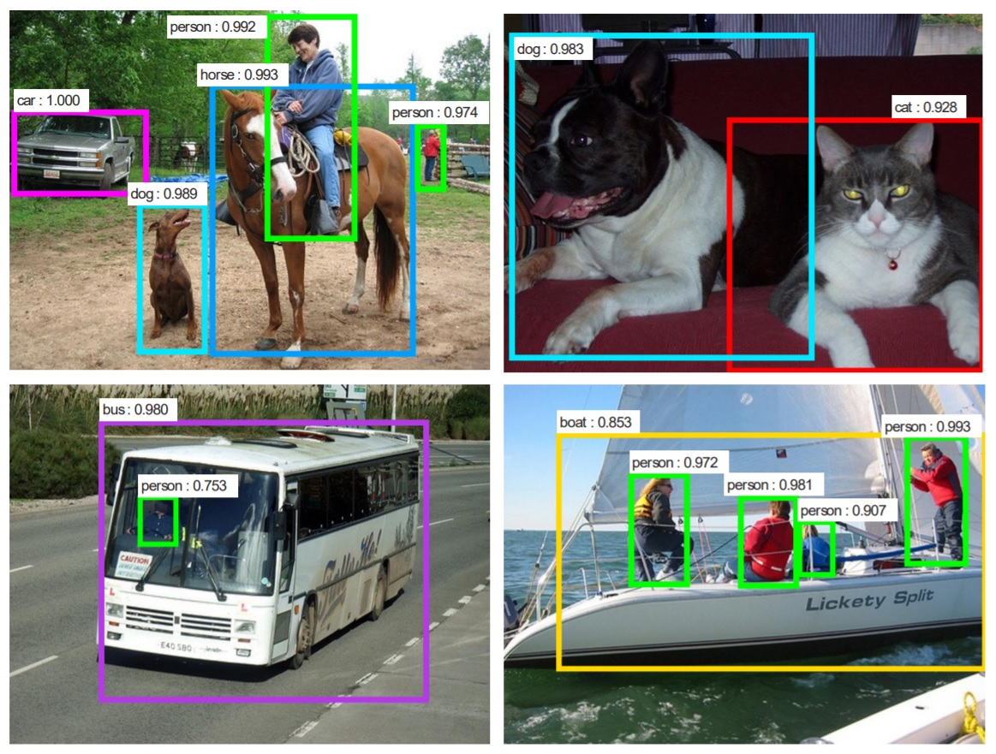
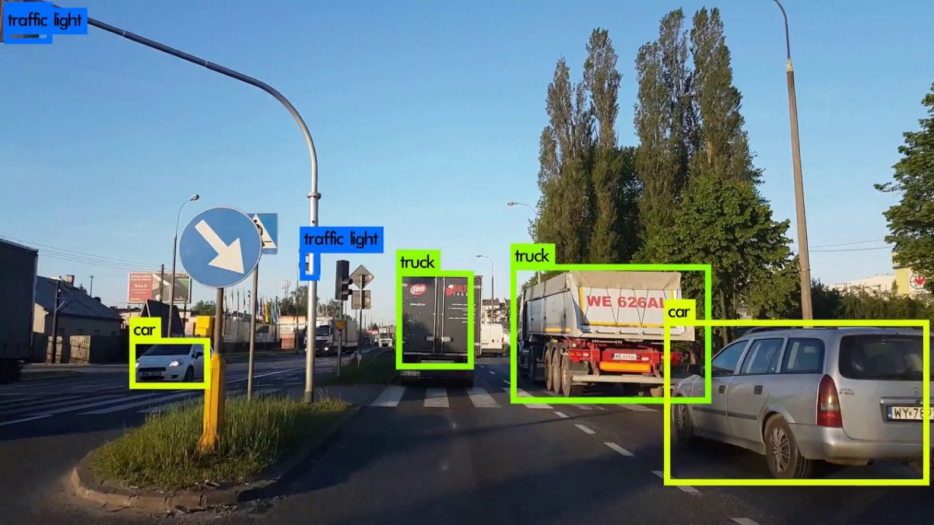
Background
Object Detection:

Slide 4
Background
Neural Network:

Slide 5
Background
Convolutional Neural Network:

Slide 6
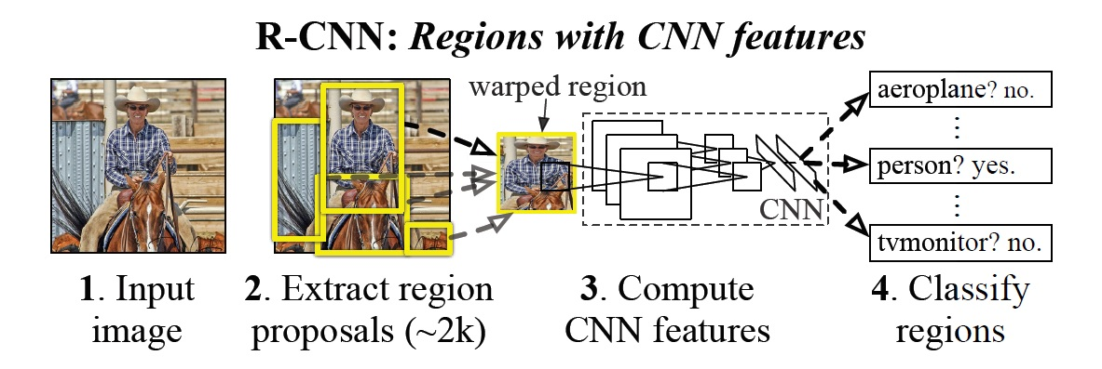
Background
RCNN

Slide 7
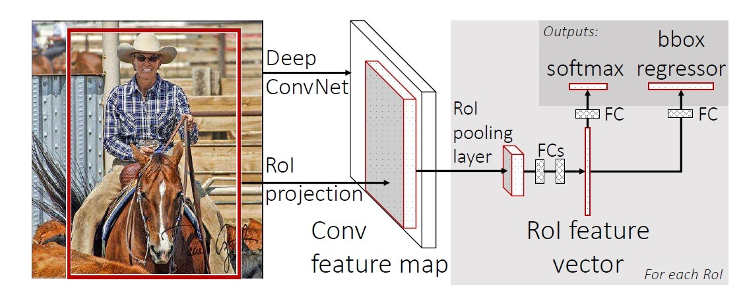
Background
Faster-RCNN

Slide 8
Research Question:
How to improve the detection rates (mAP) of table and chair through combining prior knowledge and Faster-RCNN outputs?

Slide 9
The Model
Prior Knowledge
prior distribution of relative position on chair and table:
prior distribution of scores from Faster-RCNN:
Prior distribution of chair and table numbers in an image:

Slide 10
The Model
Data
Training data (Used for fine-tuning an Faster-RCNN model and get prior information)
Testing data (Used for getting output and evaluation)
Format:
the suggested bounding boxes for each image:
category and score for each bounding boxes: chair, table or others
the ground truth bounding boxes:

Slide 11
The Model
Target:
Suppose a bounding box indicates that it contains a chair with score p, want to caculate the following posterior probability to replace the score:
If the bounding box indicates it contains a table:

Slide 12
The Model
Approximation:
Problem: we don't know the real and
Now we assume are indicators (0 or 1) which will be updated after each calculation.
Idea: Use Iteration, update a or , sampled by probability
(Same idea as Gibbs Sampling)

Slide 13
The Model
Algorithm:
Initialization: is initialized by output from Faster-RCNN
Loop:
For all i indicates containing chair:
Update by calculating and sampling
For all j indicates containing table:
Update by calculating
Where i and j are index of bounding boxes in an image.

Slide 14
Implementation details
Faster-RCNN fine-tuning and getting output for testing dataset:
1. Recode detection categories for ILSVRC training and testing datasets.
2. Fine tune Faster-RCNN for 3 classes detection based on training dataset.
3. Get the Faster-RCNN outputs for testing dataset. (As input for the improved model and comparison for evaluation)

Slide 15
Implementation details
Estimating Prior Distributions on Training Data:
(1) Position:
(2) Scores: Kernel Density Estimation (Empirical distribution)
(3) Numbers: Possion Distributions. Estimate and

Slide 16
Implementation details
Main Equation:
Part 1:
Where we assume independence within table class and chair class.

Slide 17
Implementation details
Part 2:
Where and
is calculated given Possion parameter

Slide 18
Implementation details
Part 2 (Continued):
Assumption: Ignoring chairs, the location of table are independent and uniformly distributed, a larger bounding box is more likely to contain a table.
Therefore:

Slide 19
Implementation details
Part 2 (Continued):
The denominator is calculated in the same way above.
is calculated in (almost) the same way of calculating

Slide 20
Implementation details
Model Evaluation: Calculate the mAP across table and chair classes for both Faster-RCNN outputs and improved model outputs, to see which is higher.
mAP:
Precision P = TP/(TP+ FP) Recall R = TP/(TP + FN)

